Slide 1

Recommender Systems
for Online Retail Businesses
Presented by: Lavanya Singh.
Notes:
Okay good afternoon and I will be presenting for my project which is recommended systems were online retail businesses how

Slide 2

Problem Statement
Building a recommendation system using collaborative filtering techniques
01
Finding relevant product recommendations for consumers for a boost of sales in business
Notes:
No problem statement building a recommendation system using collaborative filtering techniques which is finding relevant product recommendations for consumers for boost of sales in business

Slide 3
Project Flow
01
02
03
Data cleaning and preprocessing
feature engineering
Raw Data Overview
04
05
06
Data Visualisation
frequent itemsets
getting recommendations
Notes:
I talking about the flow of the project we overview Dharo data we clean and the process then People phone feature engineering driving newly feet new features that we can use to understand the data better data visualisation to get business insights Abhinav generate frequent item sets and we get recommendations

Slide 4
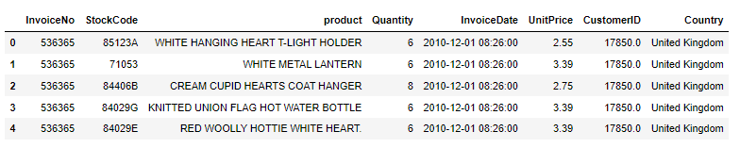
Raw Data Overview
invoice number
stock code
description
quantity
invoice date
unit price
customer id
country
the dataset:
Notes:
No rain in which the transaction had taken place we make a few observations her one of them being on the deal that the full price we have only unit price not the total price also the fact that the invoice number of the transaction numbers are Bittu shodho that we have various products in one transaction please need to be grouped later or to perform operations

Slide 5
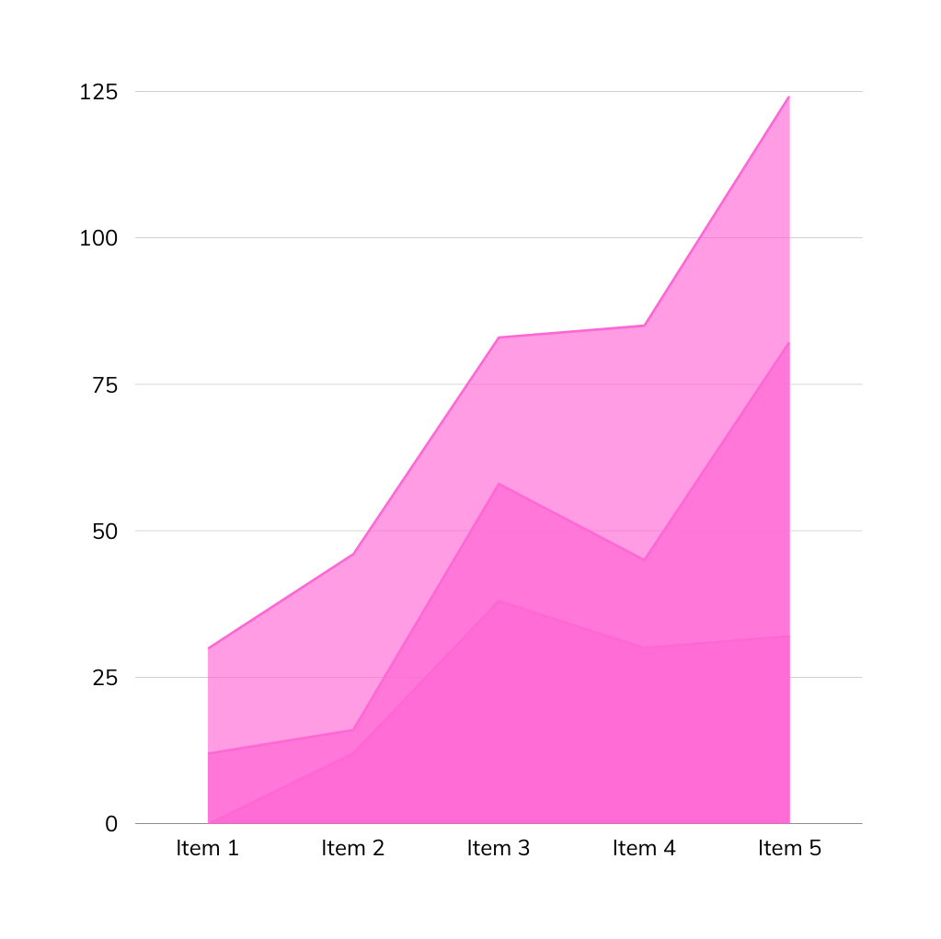
Data Analysis
analysing the trend of our data

Slide 6
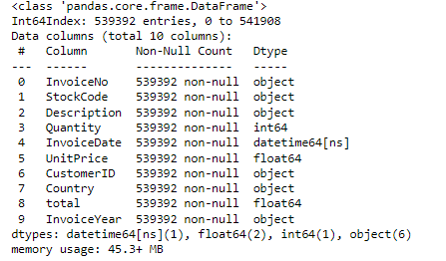
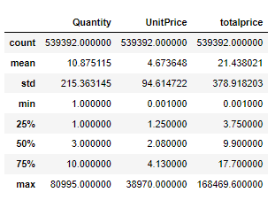
Analysing the Dataset

Slide 7
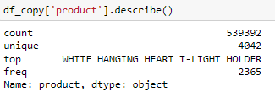
Analysing Columns

Slide 8
Data Visualization
tools/ libraries
python
matplotlib library
Notes:
I am taking a look at data visualisation and visualisation of this data in database visualisation is always useful to understand the data better and gain some business insights which can be used to take important decisions later on the tools that I have used his inner plot Library in Python moving onto the first visualisation

Slide 9
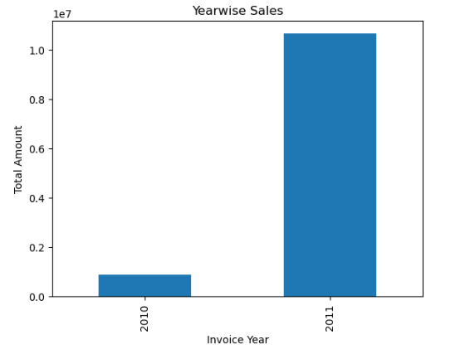
Sales year-wise
Notes:
Go on the visualisation shows your voice sales going to the tech Naa technicalities I have use the quantity: as well as the invoice your column to find out how many Tusi sorry sorry sorry I have used it's total amount column alongside the invoice years volume to get the total sales Ina particular year so we can infer from this date this visualisation that 2011 saw a great spike in sales as compare to 2010 free fire if you find out the percentage it has increased from a Yash from about 85% this is a visualisation based on your butt similarly visualisation can also brick be created a month wise Tusi the performance in that way Dharo Kucch Kucch is very funny

Slide 10
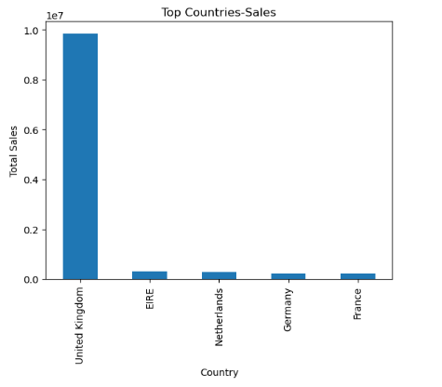
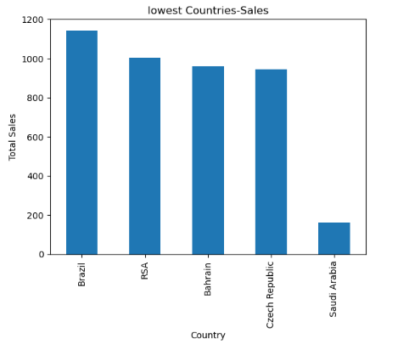
Countries with Highest Sales
Countries with Lowest Sales
Notes:
Moving on to the next visualisation Oda specialisation depicts the countries with highest sales says we can see that United Kingdom is the first country which is the country with highest kills this might signify that there are higher number of stores in United Kingdom or that the company is based in United Kingdom other than that we have four other countries E Irene Netherlands Germany and France which saw good number of seats did this is good Par Do

Slide 11
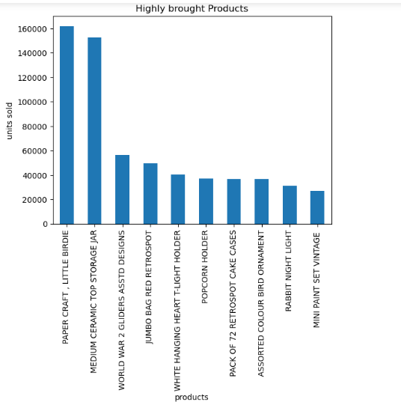
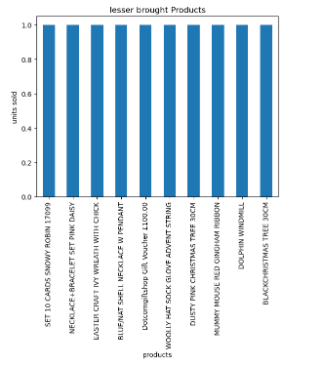
highly sold products
least sold products
Notes:
Moving on to the next visualisation Oda specialisation depicts the countries with highest sales says we can see that United Kingdom is the first country which is the country with highest kills this might signify that there are higher number of stores in United Kingdom or that the company is based in United Kingdom other than that we have four other countries E Irene Netherlands Germany and France which saw good number of seats did this is good Par Do

Slide 12
Recommendations
Frequently brought items
Model
cosine similarity
apriori algorithm
Notes:
Movie gaanta of generating frequent item such an of the concept – uses his market basket analysis and freedom frequent item sets in the town Centre used for rocket forming this is a pro real

Slide 13
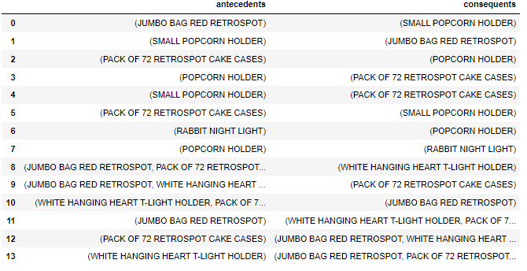
Frequently brought products
paper craft, little birdie
ceramic storage jar
world warII gliders
Jumbo red bag
white T-light holder
popcorn holder
pack of 72 cake cases
Notes:
No so this is the concept of market basket analysis and to implement this concept we need to use Diye Priori algorithm that is available in python to get the frequent item day items at a from this particular data toristiya this particular data here are the sets that are brought frequently by the consumers the incident is the product which they kept in their court first and consequent is the consequent product that they brought along with the first product yaar Tera three metrics of a priory Vichara lift confidence and support all these three metrics help us to find the frequency of which with which the products are occurring every Ghat Ghat Ghat shopping cart

Slide 14
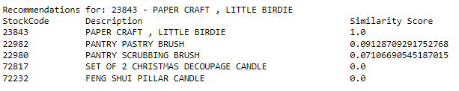
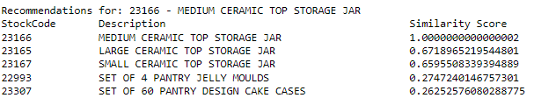

Getting recommedations for the top ten
paper craft, little birdie
ceramic storage jar
world warII gliders
Jumbo red bag
white T-light holder
popcorn holder
pack of 72 cake cases
01
02
03

Slide 15
How can your Organisation benefit from it?
making use of factors such as ratings and user purchase history
knowing what the consumer wants to predict a preferrable item
providing a more personalized approach which would translate to better revenue
Notes:
As we have discussed Sarak there will be various factors that to create various factors that are used to filter information in a way to create recommendations a few of those factors would be similarity reviews or feedback as well as past behaviour of consumers not talking about now say when comes to segregating the stripes into the filtering types similarity and reviews feedback is content content received from the consumer or by the manufacturer these are used to win these are used to create recommendations it is called as content-based filtering on the other hand collaborative filtering is based on past behaviours of consumers like the data which contains the past past behaviours or choices of consumers or recommendations are based on that

Slide 16

Thank you

